Slide 1




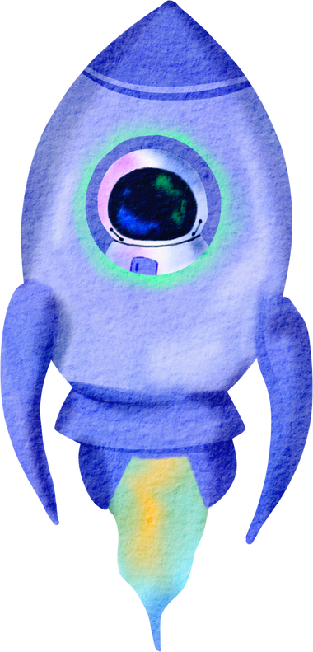
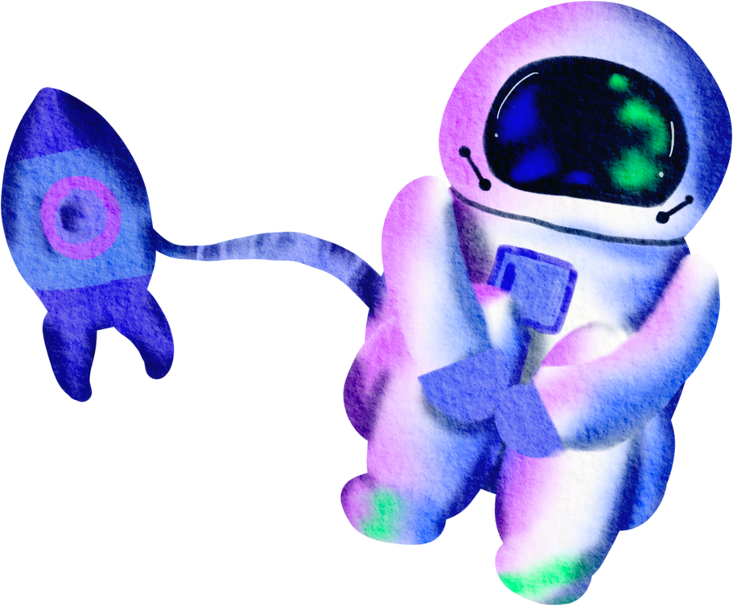


SCI
LEARN
Danaila Andreea-Valentina & Gugulea Maria-Alexandra
Group 1212EEA
Coord Teacher: Sl. Dr. Ing. Mitrea Dan Alexandru

Slide 2


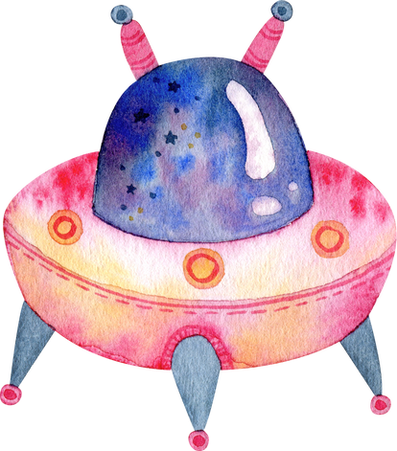








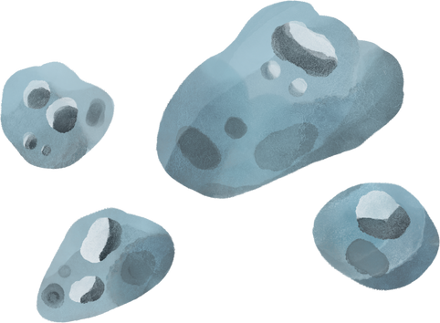
Contents
Easy to Understand Courses
Course-Specific Flashcards
Practice Quizzes
News From Space

Slide 3


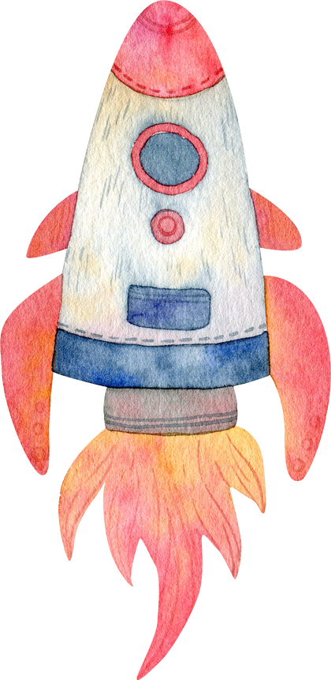



Programming Languages
1. HTML (HyperText Markup Language):
Structure and content of web pages
Defines elements like headings, paragraphs, and images
2. CSS (Cascading Style Sheets):
Styling and layout of web pages
Controls colors, fonts, spacing, and responsive design
3. JavaScript:
Adds interactivity and dynamic content
Used for animations, form validations, and interactive quizzes
API integration
4. PHP (Hypertext Preprocessor):
Server-side scripting language

Slide 4





Similar Applications
Our website is designed to provide an educational platform for children with learning disabilities, focusing on space science. It features interactive courses, engaging flashcards, and dynamic quizzes to enhance learning. Additionally, the site offers real-time space news updates, similar to the NASA website, ensuring users stay informed about the latest in space exploration.

Slide 5




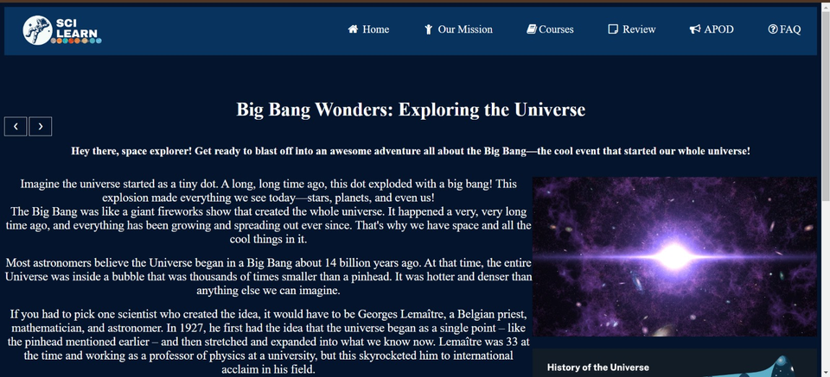
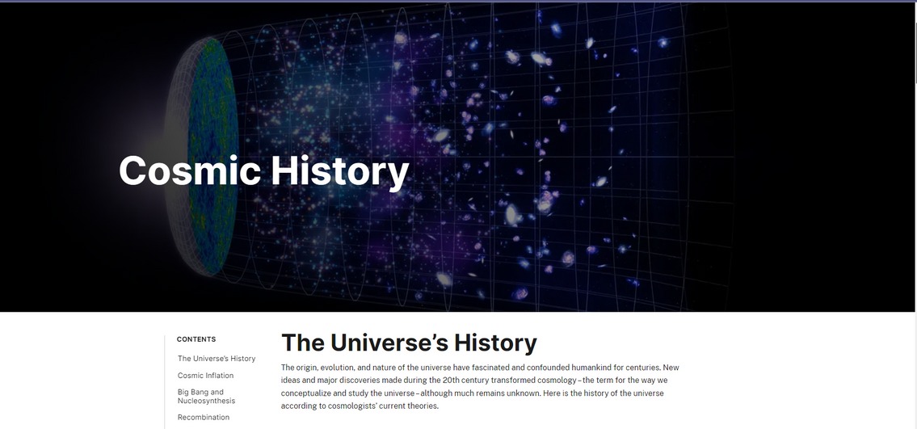

Similarities

Slide 6
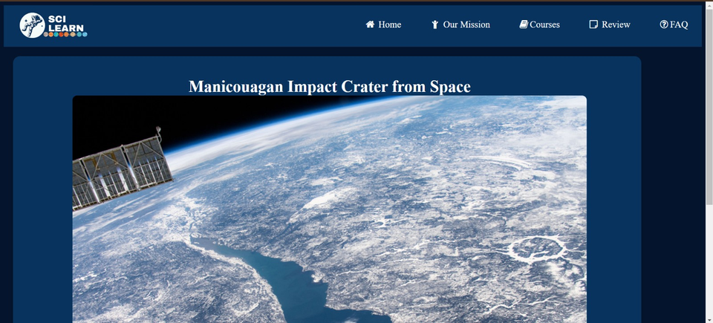
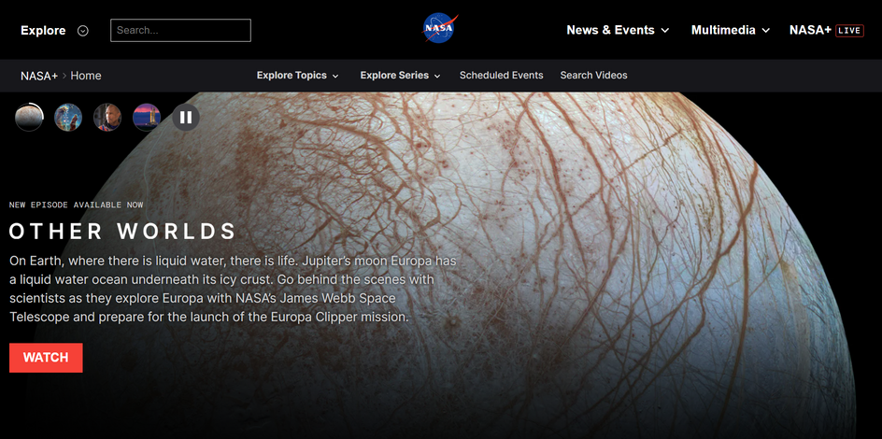
Similarities

Slide 7

Differences
1. Tailored for Learning Disabilities:
Our Website: Specifically designed for children with learning disabilities, offering simplified language, clear visuals, and accessible navigation.
NASA Website: Primarily targets a general audience with more complex information.
2. Interactive Flashcards:
Our Website: Provides flashcards after each course to reinforce learning and aid memory retention.
NASA Website: Does not offer flashcards as a learning tool.

Slide 8


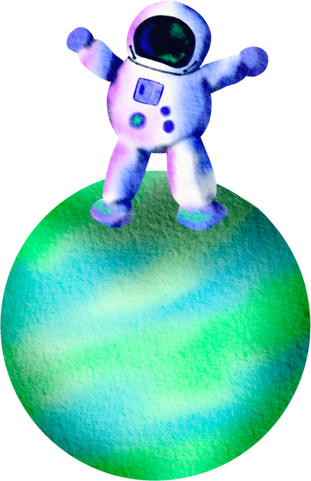

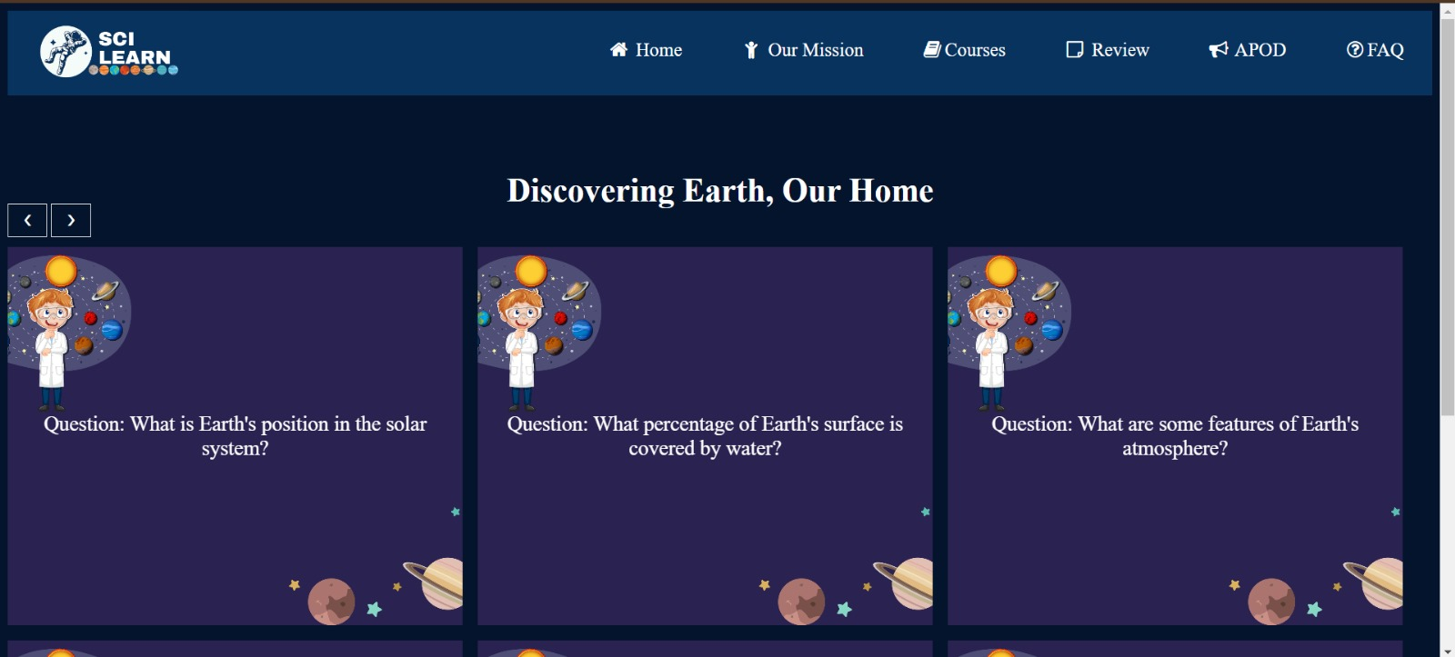
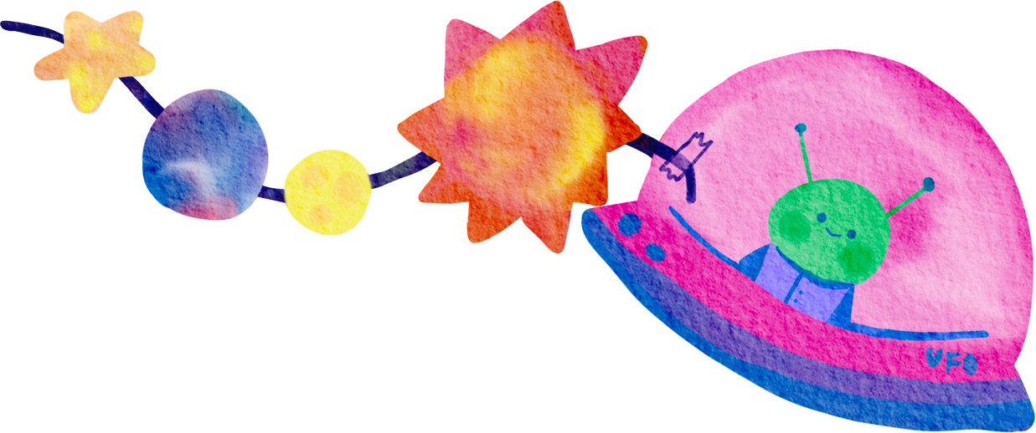
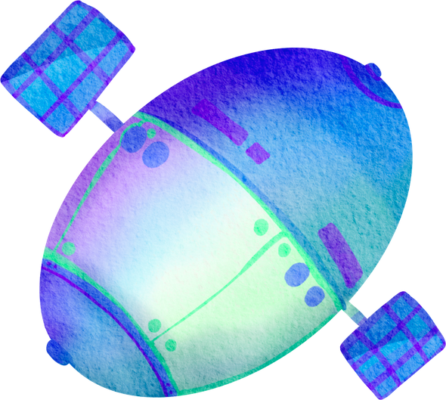

Slide 9
Differences
3. Quizzes for Assessment:
Our Website: Includes quizzes at the end of each course to assess understanding and provide immediate feedback.
NASA Website: Lacks course-specific quizzes designed for assessment and engagement.
4. Structured Learning Path:
Our Website: Offers a structured learning path with a sequential flow of courses, tailored to young learners.
NASA Website: Provides a wide range of information without a structured learning progression.

Slide 10
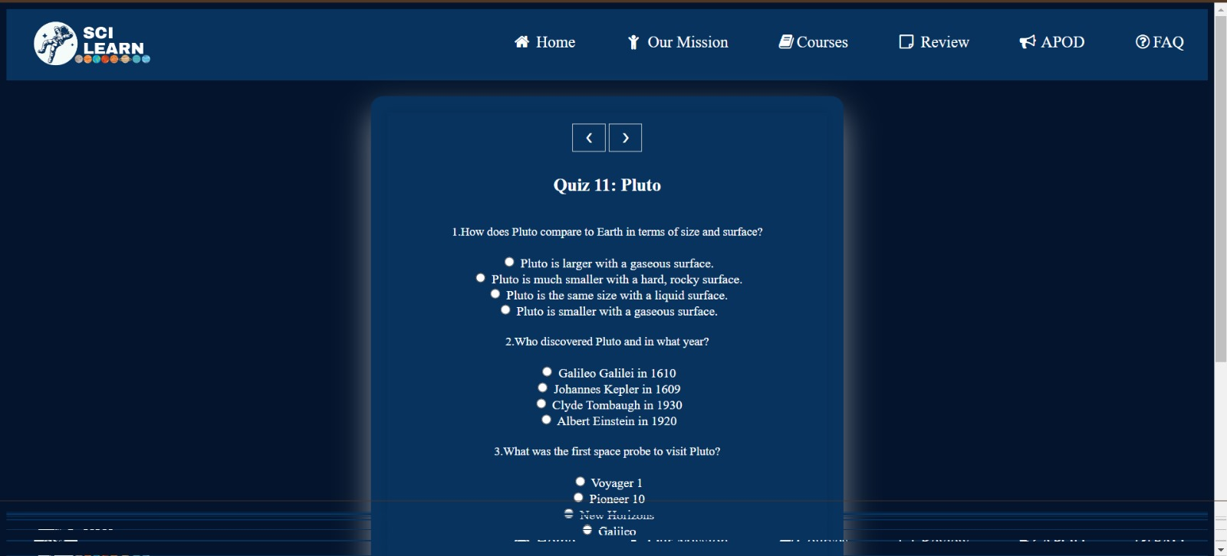

Slide 11

Objectives
Our primary objective is to make learning about space accessible and engaging for children with disabilities. Through our platform, we aim to:
Provide tailored educational content that is easy to understand and navigate.
Foster a love for learning by offering interactive courses, flashcards, and quizzes designed to accommodate diverse learning needs.
Support cognitive development and memory retention with structured learning tools.
Continuously improve accessibility features to enhance user experience and accommodate a wide range of disabilities.

Slide 12

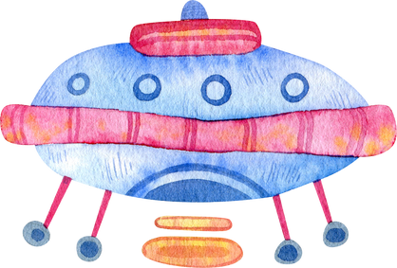




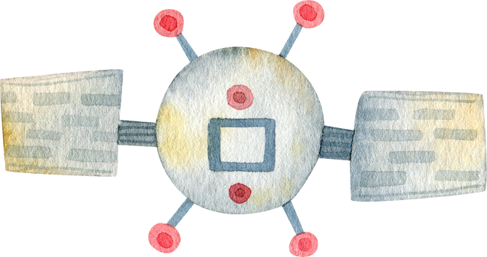




Expand content offerings to cover a wider range of topics in space science and exploration.
Develop a mobile app version of our platform to reach more users and facilitate learning on-the-go.
Project Goals
Conduct research and collaborate with experts to innovate and enhance our understanding of how best to support children with disabilities in learning about space.
Implement gamification elements to further engage and motivate young learners.

Slide 13


Conclusion
In conclusion, our website stands as a model of inclusive education, dedicated to making the vast realm of space accessible and captivating for children with disabilities. By combining interactive learning tools, tailored content, and real-time updates, we aspire to empower young learners, nurture their curiosity, and pave the way for a deeper understanding of the cosmos. With a commitment to continuous improvement and collaboration, we look forward to fostering a supportive community where every child can explore, learn, and thrive. Thank you for joining us on this journey of discovery and education.

Slide 14







